Slide 1
Game AI (Game Engines 2) Flocking, Combining Steering Behaviours, Space Partitioning
Dr Bryan Duggan
Dublin Institute of Technology

Slide 2
What we will learn
Flocking
Separation, cohesion, alignment
Combining steering behaviours

Slide 3
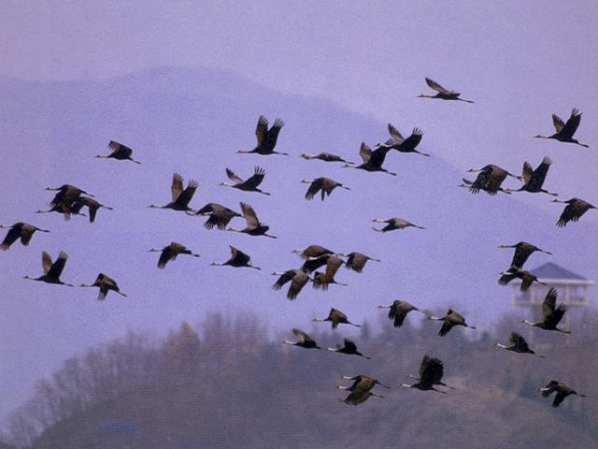
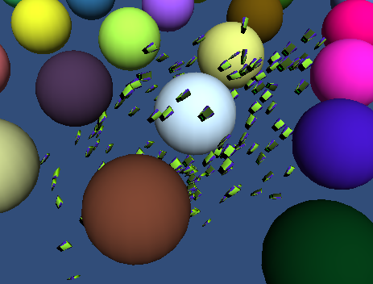
Flocking in nature
Check out these amazing videos
http://www.youtube.com/watch?v=eakKfY5aHmY
http://www.youtube.com/watch?v=iRNqhi2ka9k

Slide 4
How do we create such a magical thing?
Treat each bird as an autonomous agent
Implement some simple behaviours
Separation
If I get too close to my neighbours, push me away
Cohesion
If my neighbours get too far away, keep me close to them
Alignment
Try and go in the same direction as my neighbours
Wander
Without this the simulation would have no “intent” and would just hang there
Obstacle avoidance
So that I can avoid obstacles!
Sphere constrain
If I get too far outside the world, push me back in again
Flee
From the bad guy!
Where is the flocking behaviour??
It just “emerges” from the simple behaviours

Slide 5
First part!
For each boid we need to know our neighbours
This is significant!
Performance is O(N²)
Each new boid has to be checked against every other boid

Slide 6
private int TagNeighboursSimple(float inRange)
{
tagged.Clear();
GameObject[] steerables = GameObject.FindGameObjectsWithTag("boid");
foreach (GameObject steerable in steerables)
{
if (steerable != gameObject)
{
if ((transform.position - steerable.transform.position).magnitude < inRange)
{
tagged.Add(steerable);
}
}
}
return tagged.Count;
}

Slide 7
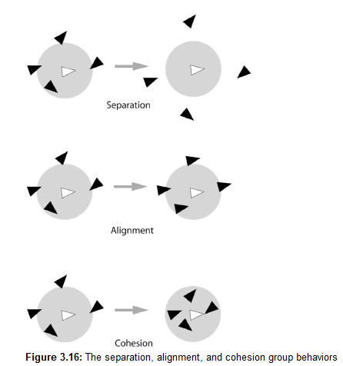
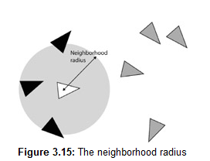

Slide 8
Separation
Creates a force that steers a vehicle away from those in its neighbourhood region.
When applied to a number of vehicles, they will spread out, trying to maximize their distance from every other vehicle
The vector to each boid is normalised, divided by the distance to the neighbour, and added to the steering force.

Slide 9
public Vector3 Separation()
{
Vector3 steeringForce = Vector3.zero;
for (int i = 0; i < tagged.Count; i++)
{
GameObject entity = tagged[i];
if (entity != null)
{
Vector3 toEntity = transform.position - entity.transform.position;
steeringForce += (Vector3.Normalize(toEntity) / toEntity.magnitude);
}
}
return steeringForce;
}

Slide 10
Cohesion
A steering force that moves a vehicle toward the centre of mass of its neighbours
Calculate the centre of mass
Seek to the position

Slide 11
public Vector3 Cohesion()
{
Vector3 steeringForce = Vector3.zero;
Vector3 centreOfMass = Vector3.zero;
int taggedCount = 0;
foreach (GameObject entity in tagged)
{
if (entity != gameObject)
{
centreOfMass += entity.transform.position;
taggedCount++;
}
}
if (taggedCount > 0)
{
centreOfMass /= (float)taggedCount;
if (centreOfMass.sqrMagnitude == 0)
{
steeringForce = Vector3.zero;
}
else
{
steeringForce = Vector3.Normalize(Seek(centreOfMass));
}
}
Utilities.checkNaN(steeringForce);
return steeringForce;
}

Slide 12
Alignment
Attempts to keep a vehicle's heading aligned with its neighbours.
The force is calculated by first iterating through all the neighbours and averaging their heading vectors.
This value is the desired heading, so we just subtract the boid’s forward vector to get the steering force.

Slide 13
public Vector3 Alignment()
{
Vector3 steeringForce = Vector3.zero;
int taggedCount = 0;
foreach (GameObject entity in tagged)
{
if (entity != gameObject)
{
steeringForce += entity.transform.forward;
taggedCount++;
}
}
if (taggedCount > 0)
{
steeringForce /= (float)taggedCount;
steeringForce -= transform.forward;
}
return steeringForce;
}

Slide 14
Combining steering behaviours
Weighted Truncated Sum
Multiply each steering behaviour with a weight,
Sum them all together
Truncate the result to the maximum allowable steering force
As every active behaviour is calculated every time step, this is a very costly method to process
behaviour weights can be very difficult to tweak
Conflicting forces
Consider an agent backed against a wall

Slide 15
Combining Steering Behaviours
Weighted Truncated Prioritised Running Sum
Good compromise between speed and accuracy
A prioritized weighted running total is calculated
Behaviours are calculated in order of priority
The force is truncated to make sure the magnitude of the steering force does not exceed the maximum available
Once the maximum force is reached, no more behaviours are calculated

Slide 16
Calculating the force for a behaviour
3 Possibilities
If there is a surplus remaining, the new force is added to the running total.
If there is no surplus remaining, the method returns false. When this happens no further active behaviours are calculated.
If there is still some steering force available, but the magnitude remaining is less than the magnitude of the new force, the new force is truncated to the remaining magnitude before it is added.

Slide 17
private bool accumulateForce(ref Vector3 runningTotal, Vector3 force)
{
float soFar = runningTotal.magnitude;
float remaining = Params.GetFloat("max_force") - soFar;
if (remaining <= 0)
{
return false;
}
float toAdd = force.magnitude;
if (toAdd < remaining)
{
runningTotal += force;
}
else
{
runningTotal += Vector3.Normalize(force) * remaining;
}
return true;
}

Slide 18
Prioritised Dithering
Checks to see if each behaviour is going to be evaluated this simulation step, dependent on a preset probability.
If it is and the result is non-zero, the method returns the calculated force and no other active behaviours are considered.
If the result is zero or if that behaviour has been skipped over due to its probability of being evaluated, the next priority behaviour is considered and so on, for all the active behaviours
Far less CPU time than the others, but at the cost of accuracy.
Requires a lot of tweaking
Probabilities can be modified without recompiling

Slide 19
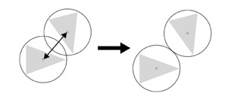
Ensuring zero overlap
Non penetration constraint
This seems to work, but really slows everything down

Slide 20
private void EnforceNonPenetrationConstraint()
{
GameObject[] boids = GameObject.FindGameObjectsWithTag("boid");
foreach (GameObject boid in boids)
{
if (boid == gameObject)
{
continue;
}
Vector3 toOther = boid.transform.position - gameObject.transform.position;
float distance = toOther.magnitude;
float overlap = GetRadius() + boid.GetComponent<SteeringBehaviours>().GetRadius() - distance;
if (overlap >= 0)
{
boid.transform.position = (boid.transform.position + (toOther / distance) *
overlap);
}
}
}

Slide 21
Spatial Partitioning
With lots of boids it is inefficient to tag neighbouring entities by comparing each one with every other one
The all-pairs method for searching for neighboring vehicles works in O(n²) time
This means that as the number of boids grows, the time taken to compare them increases in proportion to the square of their number
If processing one object takes 10 seconds, then processing 10 objects will take 100 seconds

Slide 22
Cell Space partitioning
The algorithm iterates through all the boids and assigns each one a cell
This can be 3D or 2D
instead of having to test every boid against every other, we can just determine which cells lie within a boid’s neighborhood and test against the boids contained in those cells
This makes the algorithm slower for smaller numbers of boids
But faster for larger numbers
The algorithm makes flocking O(N)

Slide 23
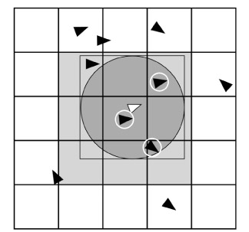
Cell Space Partitioning
An entity's bounding radius is approximated with a box.
The cells that intersect with this box are tested to see if they contain any entities.
All the entities contained within the cells from step 2 are examined to see if they are positioned within the neighbourhood radius. If they are, they are tagged.

Slide 24
In Unity

